Slide 1

CANADIAN
NATIONAL MASTER
CKC MASTER HUNT TESTS
2018
(Long Version)
Notes:
Sources For Good Information on Judging, Field Work and Setting up Good Tests
(Copy links into your browser)
Retriever Field Trial Judging – A Manual - “The Blue Book” Aimed at field trial judges but carries a large amount of information that would translate well to hunt tests and WC/I/X work
https://www.theretrievernews.com/store/p7/Judge%27s_Manual_%28Digital_eBook_Edition%29.html
Retrievers ONLINE - Dennis Voigt has published many outstanding articles on judging in his Retrievers ONLINE magazine and currently appear on his blog.
http://www.retrieversonline.com/
Retriever Field Trial Judging Fundamental and Checklist
http://cdn.agilitycms.com/retrievers-online/AMJ_2012_Judging%20Checklist-hi%20res.pdf
Retriever News
https://www.theretrievernews.com/
CKC Rules and Regulations
https://www.ckc.ca/en/Files/Forms/Shows-Trials/Event-Rules-Regulations/Hunt-Test-Rules-and-Regulations-for-Retrievers-Bar
It is easy to set up tests that eliminate dogs - all dogs can be tricked – but that is not the role of a judge. Judges should be on the dog’s side when judging – not to give it an easy pass – but to bring out the best that dog has to offer on that day.

Slide 2
Table of Contents
TOPIC | SLIDE
Purpose of CKC Hunt Tests | 3
Key Hunt Test Definitions | 4 - 6
Master Test Requirements | 7
Master Test Design Considerations | 8 - 13
Evaluating the Master Dog General Lining the Dog Talking to the Dog Recasting the Dog Handling on Marks Interference Switching on Marks Hard Mouth Sample Master Score Sheets | 14 - 28
CKC Hunt Test Performance Standards and Fault Classification | 29 - 43
Serious Handler Faults | 44 - 45
Gun Safety | 46 - 47

Slide 3
Purpose of CKC Hunt Tests
The purpose of the hunt test for Retrievers, Barbet, Irish Water Spaniels and Standard Poodles is to test the merits of, and evaluate the abilities of these dogs in the field in order to determine their suitability and ability as hunting companions
Hunt tests should, therefore, simulate as nearly as possible the conditions met in a true hunting situation
- Section 13.1.1 of CKC Rules and Regulations
The purpose of the Master Hunt Test is (also) to maintain the quality of the program
- Section 11.2.1 (a) of CKC Rules and Regulations

Slide 4
Key Hunt Test Definitions
Break
  Dog leaves to retrieve without release by handler and is not brought under control
Controlled Break
  Dog leaves to retrieve without release by handler but is quickly brought under control verbally or by whistle and returns
  In Master, a controlled break calls for a “0” score except in the Upland series where it is considered a minor fault when the dog is brought under immediate control
Creeping
  Leaving the handler on a tentative yet excited basis, short of leaving completely
  General unsteadiness
  Can be a safety issue
Notes:
Break
A break occurs when a dog makes a movement which, in the opinion of the judges, indicates a deliberate intent to retrieve without having been ordered to do so, and cannot be brought under control by the handler
Controlled break
Controlled break is when a dog leaves before being sent but is quickly brought under control by verbal command or whistle and returns to the handler
Discussion should take place at this time on controlled breaks. Controlled break can also occur when the dog stops on its own without handler communicating verbally. If the dog is watching the marks, leaves the handler’s side stops a few feet or more without handler saying sit of whistling, this is a controlled break. Controlled breaks are only while marks are going down or in Master on the sit to flush.
Creeping
Creeping is considered as leaving the handler on a tentative yet excited basis, short of leaving completely to retrieve the bird, or waiting to be sent to retrieve. General unsteadiness short of breaking:
Creeping can be a safety issue in a real hunting situation.
As a guide in their instructions to participants, judges may wish to use a hypothetical creep line of “no creeping beyond the end of the gun barrel”.

Slide 5
Key Hunt Test Definitions Cont’d
Pop
  A pop, or popping, is voluntary stopping (without command) and looking back to the handler for direction after having been sent
Diversion Bird
  A bird that is thrown and acts to divert the dog from their task at hand as it occurs
  Occurs while the dog is actively working in the field as opposed to being at the line
Poison Bird
  A poison bird is a mark, seen from the line, that is left in the field while the dog picks up a blind
  If the judge chooses to have the poison bird picked up after delivery of the blind, it will be judged as a mark
Notes:
Popping
Popping is characterized as a voluntary stopping (without command) and looking back to the handler for direction.
Discussion could take place at this point with regards to whether a pop also constitutes a dog running/moving forward but glances back.

Slide 6
Key Hunt Test Definitions Cont’d
Recast
  Distance for an allowable recast should be agreed upon by judges but is usually limited to 15 feet or 4.5 meters
  Usually attributed to a dog’s confusion as to whether it was sent
    It is not considered a recast when a dog goes to the area of the fall, fails to find the bird and returns (or is recalled)
    This must be evaluated as a lack of perseverance
Refusal
  Refusal is a disregard of a command
    Failure to stop and look at the handler when signalled or failure to continue in new direction for a considerable distance both constitute a refusal
    Not coming when called is as bad as not going when sent
Notes:
Recast
Distance should be agreed upon by judges but is usually limited to 15 feet or 4.5 meters……
Discussion could take place with regards to some of the grey areas around recasts and no-gos. Did the dog hear the handler? How should the dog be evaluated?
Refusal
Refusal is disregard of a command. Failure to stop and look to the handler when signalled, failure to continue in that new direction for a “considerable” distance constitutes refusal. Not coming when called is as bad as not going when sent.
Discussion could take place at this point with regards to what is considered as a “considerable” distance – 3 feet, 5 feet, 10 feet?

Slide 7
Master Test Requirements
A minimum of 5 hunting situations shall be tested as follows:
  One set of multiple land marks
  One set of multiple water marks
  A land blind(s)
  A water blind(s)
  Upland hunting test with quarter and flush
Each of these hunting situations can be considered a “series”
  NOTE: The word “multiple” means more than once, although triple marks are encouraged
Notes:
The blinds may be run as a double blind, one placed on land and one placed on water.
In the Upland potion of the test, the dog may be urged to hunt or handled to maintain his range and position. The bird(s) must be placed in cover within the test area. When located, the birds must be retrieved by the dog to the handler. Dead birds shall be used.
- 9.2.1(e)

Slide 8
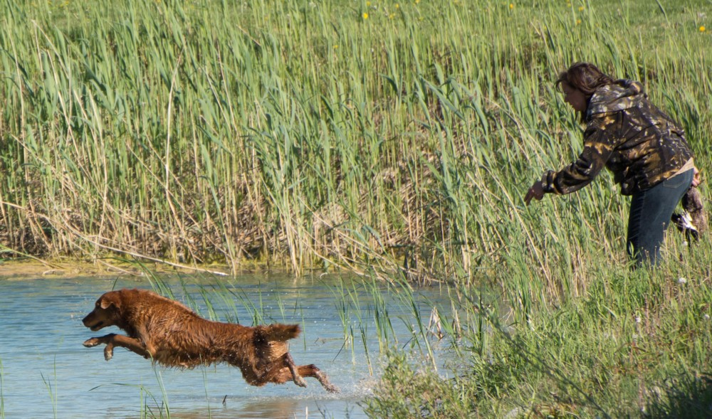
Master Test Design Considerations: General
Natural factors, obstacles and hunting equipment should be utilized to a greater degree than in a Senior test
A Master dog must honour at least once
No retrieve shall normally exceed 91.4 meters (100 yards) and will NEVER exceed 114.3 meters (125 yards)
As in Junior and Senior, situations must simulate natural and realistic hunting situations
Notes:
Discussion can take place on why visible gun stations should be kept to a minimum at Senior and Master tests.

Slide 9
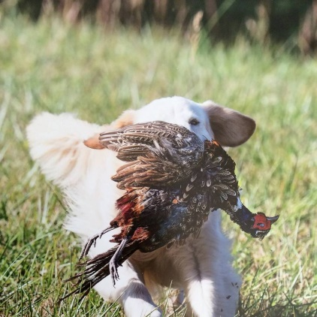
Master Test Design Considerations: Diversions
Diversion birds and/or diversion shots must be used at least once
  A diversion shot takes place with no bird thrown
  A diversion bird is a bird that is thrown in addition to the marks and blinds when the dog is actively working in the field
Diversion birds on a BLIND may be shot or thrown after the dog has been sent, or when a dog is returning from a blind retrieve
Diversion birds on a MARK shall only be used when the dog is returning from a retrieve
Notes:
Diversions
A diversion bird is thrown while the dog is out actively working in the field, not on the line. It diverts the dog from their task at hand as the task occurs.
A poison bird is a mark as it is marked from the line. The term poison bird is used to describe the concept of leaving the mark in the field while picking up a blind.
Discuss why diversion birds are part of the test.

Slide 10
Master Test Design Considerations: Poison Birds
Poison birds may be used in the Master test and are marked from the line as opposed to when the dog is active in the field (diversion)
Judges will determine whether the poison bird shall be retrieved,
  At all;
  On the way to the blind; or
  After having picked up the blind retrieve
If the judge chooses to have the poison bird picked up, it will be judged as a mark
Notes:
Poison Birds
A poison bird is a mark as it is marked from the line. The term poison bird describes the concept of leaving the mark in the field while picking up a blind.
This is as opposed to a diversion which occurs while the dog is out actively working in the field, not on the line – i.e. to divert them from their task at hand AS IT OCCURS.

Slide 11
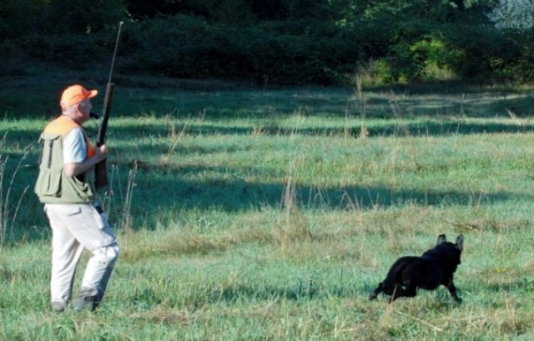
Master Test Design Considerations: Upland
In all Master tests, an upland hunt test with quartering and flush shall be used
The intent of the upland test is to demonstrate a natural tendency to quarter and hunt under control, NOT to demonstrate running a pattern
When quartering, the dog should hunt in a radius ideally 10 to 30 yards in front of the handler
The dog should be eager to hunt all available cover diligently and be under control
Notes:
At the host club’s discretion, a separate set of qualified judges (2) may be used to judge the upland hunting test. The CKC must be advised the day after the close of entries.

Slide 12
Master Test Design Considerations: Upland Cont’d
The dog may be urged to hunt or be handled to maintain his range and position but excessive handling is unacceptable
A natural flush is preferred but if a release device is used, it must be sufficiently camouflaged
When such devices are used the bird must be released in full view of the dog
The distance from the released bird to the dog should be within scenting distance
Whenever possible, the flush should be aimed away from the dog, not towards it
If birds are retrieved, they must be dead

Slide 13
Master Test Design Considerations: Upland Cont’d
Retrieves will NOT be scored as a mark but must be completed and must be delivered to hand
The dog may sit or stand with limited movement but will be disqualified if not steady to shot
The dog must be under control at the time the first shot is fired, or in the judge’s opinion, should have been fired
If a dog is steady to shot but then breaks at the fall, demonstrating an intent to retrieve without being sent, it must be stopped
  If brought under immediate control, it shall be considered a controlled break and a minor fault

Slide 14
Evaluating the Master Dog: General
A retriever’s prime purpose is to get bird to hand as quickly as possible in a pleasing and obedient manner using both natural and trained abilities
A Master test usually consists of 5 series:
  Land marks, Water marks, Land blind, Water blind, Quarter and flush (Upland)
In each series, each of the abilities must be assessed out of 10
  Marking
  Style
  Perseverance
  Training
These abilities will be scored against a standard as described in CKC Rules and Regulations and NOT in relation to other dogs
Notes:
These abilities (Marking, Style, Perseverance, trainability) will NOT be defined in relation to the performance of the other dogs but instead against the standard as set out in the CKC hunt test rules and regulations.
Judges should compare their scores early in the test and throughout the test to see if they are relatively consistent in their numbers.

Slide 15
Evaluating the Master Dog: General
Scores must be shown to handlers upon request
To qualify, an average score of 7 for the whole test (all series) must be achieved and must NOT include a score below 5 in any one ability (Marking, Style, Perseverance, Training)
When a dog is graded “0” by two judges on the same ability, it shall not be called back
A zero score is different from a non-score
  A “0” indicates that the dog had an opportunity to exhibit an ability but failed to do so
  A “non-score” indicates that an opportunity for the dog to exhibit an ability did not present itself
Trainability, as evidenced in steadiness, control, response and delivery, must be evaluated more stringently than in Senior

Slide 16
Evaluating the Master Dog: General Cont’d
It is sufficient cause to grade the dog “0” in marking or perseverance (unless valid mitigating circumstances exist in the judge’s opinion) if the dog, having been sent to retrieve a mark,
  Returns to its handler before finding a bird, with or without having been called in, except in those cases of the dog’s confusion as to whether it was really ordered to retrieve;
  Stops its hunt; or
  Fails to pick the bird up after finding it
The ability to mark is of primary importance
When ordered to retrieve, a dog should proceed quickly and eagerly on land or in water to marked falls, or on blinds
A dog should not disturb too much cover and should respond quickly and obediently to any further directions given by the handler

Slide 17
Evaluating the Master Dog: General Cont’d
A dog which pays no attention to many whistles and/or directions can be assumed to be weak in response and, unless the judges agree there exist valid mitigating circumstances, the dog should be graded low or “0” in trainability
Master dogs must exhibit those qualities expected in a truly finished and experienced hunting companion
Failure of a Master dog to be steady and deliver to hand must be graded “0” in trainability
A Master dog that creeps must be scored relatively lower than a Senior dog that creeps
A controlled break in Master must be scored “0” in trainability, except in an Upland series where it is considered a minor fault
A dog displaying unwillingness must be scored relatively lower on marking and perseverance than in a Senior test

Slide 18
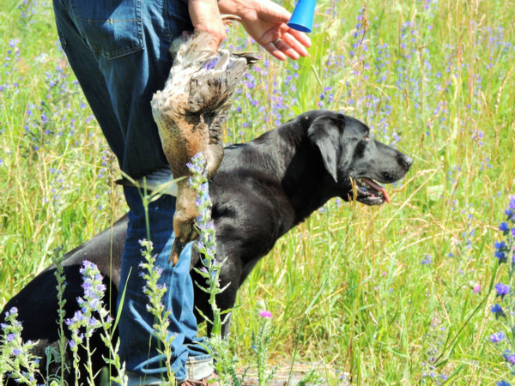
Evaluating the Master Dog:
Lining the Dog
In marking situations, the handler should not line a dog with his or her hand in the direction of any fall or gun station until all falls are down
A handler may give the dog a line in the direction of the fall, provided that such lining is accomplished briskly and precisely
Conspicuously intensive lining with the hand suggests a weak marking ability and the dog must be graded low in marking
Notes:
“In marking situations, a handler may give the dog a line in the direction of the fall, provided that such lining is accomplished briskly and precisely. Conspicuously intensive lining suggests a weak marking ability and the dog must be graded low in marking. The handler shall NOT line a dog in the direction of any fall or gun station until all the falls are down.”
- Section 12.6 pg. 46

Slide 19
Evaluating the Master Dog:
Talking to the Dog
Handlers of the working and honouring dogs should ideally remain silent from first shot until dog is released by the judge
Repeatedly speaking to the dog within one or more than one series indicates an undesirable lack of steadiness or marking ability and must be scored “0”
However, the handler may very quietly give an occasional command on an unclear mark without incurring a penalty
A handler may speak quietly to the dog to prevent forward motion (controlled break) but repetition of this will require “0” in trainability
At any time, if the judges deem the handler to be loud or intimidating, the dog will be scored “0”
If the handler of an honouring dog makes a loud noise or command which might interfere with a competing dog, the judge at her/his discretion may disqualify the offending team

Slide 20
Evaluating the Master Dog: Recasting the Dog
Dogs should be sent to retrieve only once
A recast occurs when a dog leaves for a mark, but stops within a short distance (approximately 5 yards/4.5 meters) and returns or is recalled after which the dog is sent again
This can result from the dog’s confusion as to whether it was actually sent
It is NOT considered a recast when the dog goes to the fall area, fails to find the bird or blinks a bird it has found, and returns or is recalled
This is regarded as lack of perseverance and can merit “0” in marking or perseverance unless the judges perceive valid mitigating circumstances
Notes:
Discussion should take place at this point by asking the question, “How do you distinguish between a refusal and confusion?”
Factors to consider are:
Did the dog hear the command?
Was the command too loud so as to startle the dog?
Could the conditions that the dog is expected to enter be considered to test their perseverance such as cold or murky water (possibly leading to refusal)

Slide 21
Evaluating the Master Dog: Handling on Marks
A dog may be handled on marks but excessive handling requires a lower score in perseverance and must be scored more stringently in marking and perseverance than in Senior
A dog that goes to the area of the fall and finds the bird unaided should be scored appreciably higher than a dog that must be handled to a bird
Master dogs that require excessive handling on marks and blinds, refuse voice or hand whistles or who appear reluctant to work must be viewed differently from the not-so-seasoned Senior dogs where a degree of tolerance is necessary

Slide 22
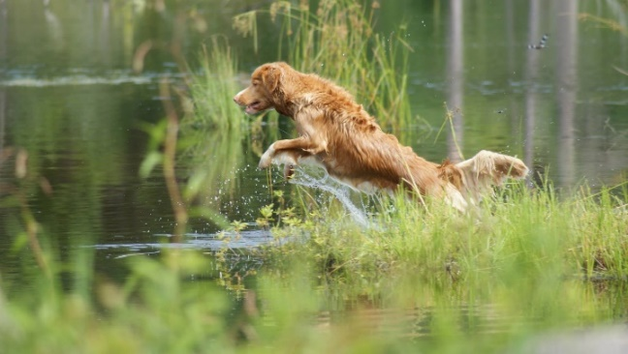
Evaluating the Master Dog: Interference
In the case of another dog breaking for the same fall as the working dog and interfering with the working dog that in any way causes a faulty performance, the working dog should be considered as not having been tested and given another opportunity to be evaluated
If the handler of an honouring dog makes a noise or command which might interfere with the working dog, the judges have discretion to remove the offending team from the test

Slide 23
Evaluating the Master Dog: Switching
A dog is considered to have switched if it:
  Goes to the area of a fall, hunts, fails to find the bird and then leaves the area to hunt for another fall; or
  Drops a bird it is retrieving and goes for another bird
Unless the judges agree that valid mitigating circumstances exist, a dog that switches shall be scored “0” in perseverance and eliminated
It should NOT be considered a switch, and therefore lack of perseverance, if the dog:
  Finds another bird on the way to one fall and retrieves it first, or
  Changes direction before reaching the area of one fall, does not establish a hunt and retrieves another bird

Slide 24
Evaluating the Master Dog: Hard Mouth
Hard mouth is one of the most undesirable traits in a retriever
A dog can carry the stigma for life and therefore hard mouth requires incontrovertible proof
Torn skin or flesh alone is not usually sufficient evidence for proof as it may be caused in a variety of ways, such as by sharp sticks or stones, etc. in the cover as well as by the dog’s fast, positive pick-up
Crushed bone structure can usually be accepted as trustworthy and sufficient evidence of hard mouth

Slide 25
Evaluating the Master Dog: Hard Mouth Cont’d
Other undesirable traits are frequently confused with hard mouth such as freezing with bird in mouth
A hard mouthed dog may still have a gentle delivery and a reluctant or sticky delivery does NOT imply hard mouth
Rolling or mouthing the bird during a retrieve may be erroneously associated with hard mouth as well even when the bird is not damaged
Such mouthing may not necessarily call for a lowering of a trainability score
The judge should remember a dog either does or does not have a hard mouth, and if it does, cannot receive a qualifying score

Slide 26
Evaluating the Master Dog: Sample Score Sheet 1
Notes:
Master test usually consists of the following 5 series: - Land marks, Water marks, Land blind, Water blind, Quarter and flush
To qualify, an average score of 7 for the whole test (all series) must be achieved and must NOT include an average score below 5 in any one ability (Marking, Style, Perseverance, Trainability)
Possible Scoring Methods:
Determine whether dog should qualify in that ability category, which might mean an ability score of 5. Knowing the dog must have an overall average of 7, the judge considers whether other abilities deserve a 7 or higher. With a five or less (but not with a zero by both judges), the dog would have to score higher in that ability and other abilities to acquire the 7 overall average.
A judge might want to compare the scores to grades received in school. For example, a 5, 6 or 7 might be comparable to a passing grade of C, an 8 would be a B, etc.
Another method could begin with a perfect score of 10 and progress downward.
Judges should take time to review and check their scores with each other before their scores become final.
The score sheet sample above represents a SOLID PASS.

Slide 27
Evaluating the Master Dog: Sample Score Sheet 2
Notes:
Master test usually consists of the following 5 series: - Land marks, Water marks, Land blind, Water blind, Quarter and flush
To qualify, an average score of 7 for the whole test (all series) must be achieved and must NOT include an average score below 5 in any one ability (Marking, Style, Perseverance, Trainability)
Possible Scoring Methods:
Determine whether dog should qualify in that ability category, which might mean an ability score of 5. Knowing the dog must have an overall average of 7, the judge considers whether other abilities deserve a 7 or higher. With a five or less (but not with a zero by both judges), the dog would have to score higher in that ability and other abilities to acquire the 7 overall average.
A judge might want to compare the scores to grades received in school. For example, a 5, 6 or 7 might be comparable to a passing grade of C, an 8 would be a B, etc.
Another method could begin with a perfect score of 10 and progress downward.
Judges should take time to review and check their scores with each other before their scores become final.
The score sheet sample above represents a CLEAR FAIL as the dog blew up in the 4th series - water marks.

Slide 28
Evaluating the Master Dog: Sample Score Sheet 3
Notes:
Master test usually consists of the following 5 series: - Land marks, Water marks, Land blind, Water blind, Quarter and flush
To qualify, an average score of 7 for the whole test (all series) must be achieved and must NOT include an average score below 5 in any one ability (Marking, Style, Perseverance, Trainability)
Possible Scoring Methods:
Determine whether dog should qualify in that ability category, which might mean an ability score of 5. Knowing the dog must have an overall average of 7, the judge considers whether other abilities deserve a 7 or higher. With a five or less (but not with a zero by both judges), the dog would have to score higher in that ability and other abilities to acquire the 7 overall average.
A judge might want to compare the scores to grades received in school. For example, a 5, 6 or 7 might be comparable to a passing grade of C, an 8 would be a B, etc.
Another method could begin with a perfect score of 10 and progress downward.
Judges should take time to review and check their scores with each other before their scores become final.
The score sheet sample above should be discussed. In this case, the dog was carried to the final series as a numerical pass is still possible after each series. The poor quarter in the final series resulted in a failing score.

Slide 29
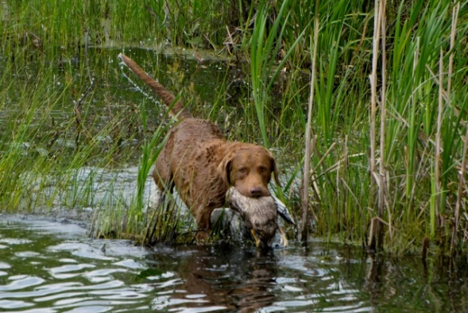
CKC Performance Standards and Fault Classification
In the Canadian Kennel Club rule book:
  Performance Standards provide a model for exemplary performance and,
  Faults Classification provide an aid to assessing how a performance deviates from the ideal until the point of being unacceptable
Note that, in order to facilitate discussion on judging, both the Performance Standards and Faults Classification apply to all 3 test levels and should be judged accordingly except where a specific test level is referred to

Slide 30
Performance Standards:
Marking
A good to excellent marking performance may be defined when the dog:
  Gives indications of having marked the fall and proceeds to the general area of the fall
  Indicates a clear line to the fall and recognition of the depth of the fall
  Proceeds directly to the area of the fall and puts on a focused hunt for the bird with little straying from the area of the fall
  Quickly and systematically locates the bird
A dog that misses the fall on the first cast but recognizes the depth of the area of the fall, stays in it, then quickly and systematically hunts it out has done a creditable job of marking
Notes:
It can be useful to define the area of the fall to the handlers in advance; especially at the Junior and Senior levels. Since the judges should have agreed upon this already, it could be shared with the handlers.
Ability to mark does not necessarily imply pin-pointing the fall, but a dog should proceed directly to the area of the fall and establish a hunt. A dog that misses the fall on the first cast but recognizes the depth of the area of the fall, stays in it, then quickly and systematically hunts it out has done both a creditable and an intelligent job of marking. - 15.1.2
Marking or memory of falls is of paramount importance. However, this does not imply that dogs which excel in marking shall not be scored lower, even to the extent of not receiving a qualifying score, for deficiencies in, or a lack of the other required abilities.
In determining the arbitrary boundaries of the area of the fall, due consideration should be given to many factors:
Type, height and uniformity of cover
Light conditions
Wind direction and intensity
Length of the various fails
Location of fall (beyond a hedge, across a road, etc.)
Single, multiple or 2nd or 3rd bird
Discussion could take place at this point with regards to possible additional factors.

Slide 31
Performance Standards:
Marking Cont’d
Determining the arbitrary boundaries of the area of the fall should consider cover, terrain, light, wind, distance and location of fall etc.
  What are other factors that should be considered?
  It can be useful to define the are of the fall to the handlers in advance; especially at the Junior and Senior levels
It is important to understand that when a dog disturbs cover unnecessarily, is clearly out of the area of the fall and has not been handled, it should be scored lower on marking than if it was handled quickly and obediently to the bird (as per section 15.1.7. of the CKC rule book)
Notes:
Evaluations should take into consideration the distance which a dog wanders out of the area of the fall, the frequency of such wandering, the number of birds mismarked and the amount of cover disturbed in these wanderings.

Slide 32
Classification of Faults:
Marking
Serious:
  In Junior, handling on more than one mark
  Multiple birds mismarked
  Failure to find a bird which should have been found
Moderate
  Failure to proceed directly to the area of the fall and initiate a hunt, disturbing cover clearly out of the area of the fall
  In Master, failure to go directly to the area of the fall and set up a hunt, requiring the dog to be handled
  Conspicuously intensive lining after the falls are down suggests weak marking
Minor
  In Junior, single recast
  Handling “on” a mark as opposed to “to” a mark
Notes:
Under minor faults, handling “on” a mark has quotes around it to distinguish between handling “on” vs handling “to” a mark.
The distinction between “on” and “to” is based on proximity.
A classic example of handling “on” a mark is when a dog takes a good line and ends up passing the bird a couple of feet on the upwind side. In this case, if the handler quickly whistles and handles “on” to the bird, this would be a minor fault. The hunt test rules say that a quick handle is better than a long hunt. When a dog puts on a big hunt and is not close to the bird and needs to be handled a longer distance, this handling “to” the mark. Often judges are heard to say that two handles of this kind will result in a fail, so these handles should be seen as moderate faults.
“In marking situations, a handler may give the dog a line in the direction of the fall, provided that such lining is accomplished briskly and precisely. Conspicuously intensive lining suggests a weak marking ability and the dog must be graded low in marking. The handler shall NOT line a dog in the direction of any fall or gun station until all the falls are down.”
- Section 12.6 pg. 46

Slide 33
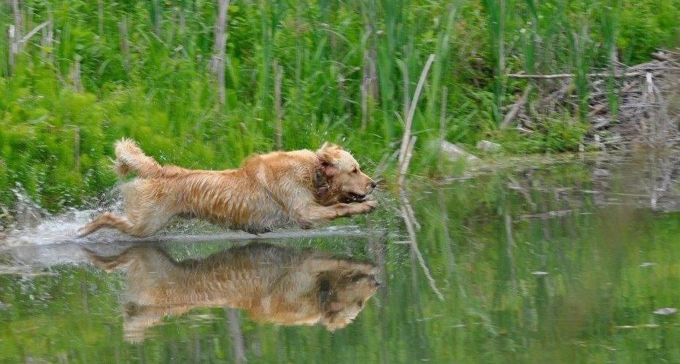
Performance Standards:
Style
Good to excellent style may be defined when the dog shows:
  An alert and obedient attitude
  Determined departure on land and into water
  An aggressive search for the fall, a prompt pick-up, and
  A reasonably fast return
Absence of these style components should be reflected in a dog’s score, even to the point of scoring a dog “0” on style
Notes:
Discussion could take place at this point on additional elements of style such as body language – ear and tail position.
How does speed factor into style? For example if the dog is older or dysplastic?

Slide 34
Classification of Faults:
Style
Serious:
  In Master Upland test, excessive handling to maintain range and position
Moderate:
  Hunting in a slow, lackadaisical, disinterested manner
  Lack of alert, obedient attitude, lack of determined departure on land or on water, lack of aggressive search for the fall, lack of prompt pick up and return
Minor
  Lack of attention
  Slow pick-up of a dead bird (except when fluttering or badly shot up
  Dropping bird or handling bird in a sloppy manner

Slide 35
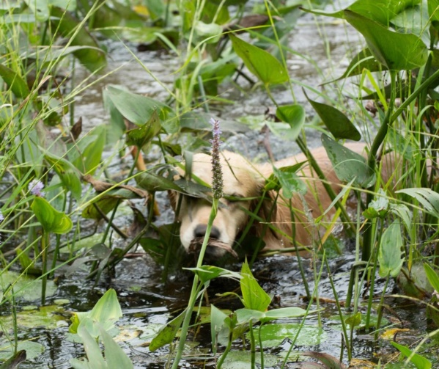
Performance Standards:
Perseverance
Perseverance and courage in hunting is shown by a dog’s determination to stick at it and complete the task at hand (i.e. systematically, aggressively, and without faltering) to search for and find the bird he is to retrieve
Willingness to face, without hesitation and repeatedly, rough cover, cold or rough water, ice, mud or other similar conditions which make the going tough

Slide 36
Classification of Faults: Perseverance
Serious
  Failure to enter uncomfortable circumstances (e.g. rough cover, water, ice, mud) after having been ordered to do so several times
  Switching birds - Establishing a hunt in one area of the fall, then giving up and establishing a hunt in another area of the fall; or drops a bird retrieved and goes for another
  On a mark, returning without the bird, except in a recast situation
  Stops its hunt
  “Blinks” a bird – fails to pick the bird up and leaves it after making the find
Notes:
Failure to enter potentially uncomfortable circumstances – Section 12.13 – In Senior and Master failure to enter either rough cover, water, ice, mud, or any other situation involving unpleasant or difficult going for the dog, after having been told to do so several times, is sufficient cause to grade the dog “0” in perseverance.
Section 9.3.4:
“Dogs that switch shall be scored “0” in perseverance and cannot receive a qualifying score.”
Discussion should take place on the influence of tightness of marks on switching (first bird picked up, dog sent to second area of fall, can’t find it, goes back to first mark. Is this a switch if marks are tight? This should be discussed by judges before evaluations begin.
“Blinking” a bird is a failure to pick up a bird leaving it after making the find. Judges should confer when there is a question of a dog blinking a bird.

Slide 37
Classification of Faults:
Perseverance Cont’d
Moderate:
  Reluctance to enter uncomfortable circumstances (e.g. rough cover, water, ice, mud) or other situations involving unpleasant going for the dog
  Popping on a marked retrieve –stopping and looking back to handler for directions on a mark
Minor:
  Popping, stopping and looking back for directions on a blind retrieve where there are no extenuating circumstances
  In Junior, a single recast
Notes:
Discussion could take place on what could be defined as “extenuating circumstances” against Minor Faults on a pop.

Slide 38
Performance Standards:
Trainability
Trainability consists of those abilities that the dog acquires through training
  Steadiness: Lack of movement on the line
  Control: Closely aligned to the dog’s response to direction and includes obedience and line manners
  Response: Important in handling tests and in situations where a dog must be brought back to the area of the fall when it has mismarked
  Delivery: Bird must be delivered to the handler directly upon return from the retrieve and given up willingly
Notes:
Trainability
Trainability score will vary with both the nature of the test being scored and the extent to which a dog might be unresponsive. Before scoring a dog lower on trainability for its failure to stop promptly at a whistle, judges should determine whether the wind, cover or the distance seriously interfered with the dog’s ability to hear its handler. In general, the response displayed should be considered in its entirety; an occasional failure to take and hold a direction may affect a trainability score only slightly, if offset by several other very good responses.
To the extent that a dog might not receive a qualifying score, a trainability score must reflect repeated and willful disobedience of the handler’s orders. In addition, but to a lesser extent, a trainability score must show that, after taking the proper direction, the dog did not continue on it as far as the hander desired. Stopping voluntarily to look back for direction, in an isolated instance, may warrant a moderate or slight lowering of a trainability score, but frequent stopping can result in a zero (0) score.

Slide 39
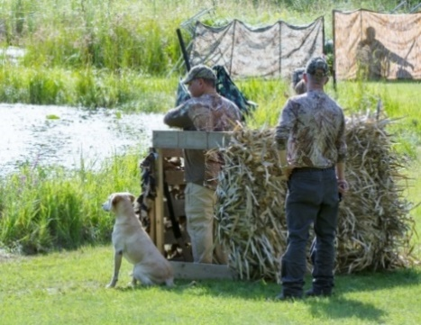
Classification of Faults:
Trainability - Steadiness
Serious:
  In Master, a break or controlled break by the working or honouring dog results in mandatory elimination, except in the Upland test where a controlled break is allowed on the flush
Moderate:
  In Senior, a controlled break, after which the dog is brought under control and providing it does not interfere with the working dog
  Extreme or persistent creeping or serious lack of steadiness and general poor line manners
  In Master, talking to the working or honouring dog
Notes:
Steadiness
In a Master hunt test the handlers of the working and honouring dogs should remain silent from the time the first shot is fired until the dog is released by the judge.
However, the handler may very quietly give an occasional command to facilitate a difficult-to-see mark without incurring a penalty.
Any speaking to the dog once the first shot is fired detracts from a perfect performance and must be reflected in the trainability score.
Repeatedly speaking to the dog within one series or during more than one series indicates either an undesirable lack of steadiness or a lack of marking ability and must be scored “0”.
A handler may speak quietly to his dog to prevent forward motion but repetition of this fault will necessitate a “0” in trainability.
At any time, if the judges deem the handler to be loud or intimidating, the score will be scored “0”.
Section 12.6 (c)
Discussion could take place on what constitutes an allowable “controlled break” on the flush in Master.

Slide 40
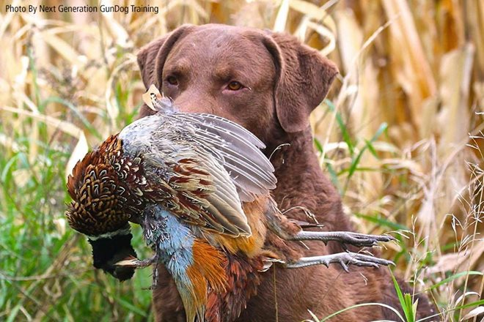
Classification of Faults:
Trainability – Steadiness Cont’d
Minor:
  Unsteadiness on the line, including creeping
  In Junior, controlled break
  In Master, controlled break in Upland
  In Senior and Master, creeping
  In Senior, talking to the working dog or honouring dog
    It is desirable that the handler remain silent from the time the first shot is fired until release by the judge

Slide 41
Classification of Faults: Trainability - Control
Serious:
  Dog is allowed to hunt extensively after handling on a mark/blind has begun
  Dog is out of sight on a blind for an unreasonable time
  Loud and prolonged barking or whining
Moderate:
  Moderate whining of short duration
  Recast
Minor
  Slight short whine or one bark on line or on send
  In Junior, a single recast
  Poor line manners; poor heeling, dropping bird on delivery, jumping after birds, etc.
Notes:
Control
In Senior and Master, includes walking tractably at heel, off lead, assuming and staying I n any designated position on line, as well as remaining quietly on line beside the handler after delivery of the bird.
When called, a dog should return promptly to its handler.
Except for extraordinary circumstances, noisy or frequent restraining of a dog on line by its handler is sufficient cause not to award a qualifying score in Senior and Master.
In less flagrant instances, the trainability score should correspond to the extent that the dog might be deemed to be out of control.

Slide 42
Classification of Faults:
Trainability - Response
Serious:
  Many refusals unless mitigating circumstances exist
  Failure to return when called
  Repeatedly popping on a blind
Moderate:
  Multiple whistle/cast refusals
Minor:
  One whistle/occasional cast refusal unless mitigating circumstances exist
  Popping, stopping and looking back for direction on a blind retrieve where there are no extenuating circumstances
Notes:
Response
A dog should respond to direction and continue on until it either makes the find, or until stopped by its handler and given a new direction. Lower scores, even to the extent of grading a dog zero on trainability, based on a lack of response, may be the result of the following:
Not taking the direction originally given by the handler
Not continuing in that direction for a considerable distance
Failure to stop promptly and popping up and looking back for direction
Failure to stop promptly and look to the handler when signalled
Failure to take a new direction when given
Failure to continue in that new direction for a considerable distance
Discuss how judging of Senior and Master should differ in terms of nature and number of cast refusals.
Discuss what additional factors may result in lower scores or “0”.
Discuss what valid mitigating circumstances could exist that result in refusals.
Weather conditions can play a huge part in mitigating circumstances and some land/water that is available could cause issues.
Running through splash water sometimes causes dog to not hear commands/whistles
Discuss what extenuating circumstances could exist if the dog refuses, pops, stops, and looks back for direction on a blind retrieve.

Slide 43
Classification of Faults:
Trainability - Delivery
Serious:
  Failure to deliver to hand
  Freezing – refusal to release a bird for an unreasonable period of time or until compelled to do so
  Hard mouth – badly damaging a bird or making it unfit for human consumption which, in the opinion of the judges, was caused solely by the dog without justification
  Retrieving a decoy
Minor
  Slight freezing – reluctance to give up a bird
  Roughness with game
Notes:
Delivery
A dog should not drop the bird before delivering it and should not freeze, or be unwilling to give it up.
A dog should not jump after the bird once the handler has taken it.
A faulty delivery may, depending on the nature of the test, range from a slight lowering of the trainability score for an isolated offense, to the withholding of a qualifying score for a severe freeze or “hard mouth”.

Slide 44
Serious Handler Faults
In Master and Senior, carrying exposed training equipment (example; crop)
Lining a dog in direction of a fall or gun station before falls are down
The handler of an honouring dog makes noise or gives a command loud enough to interfere with the working dog
Unsportsmanlike conduct: Abusing or harassing any person present or kicking, striking or otherwise roughly manhandling a dog
Lack of safe gun handling

Slide 45
Serious Handler Faults Cont’d
Deliberately permitting a dog to see the location of a fall for another dog, or to see the planting or retrieve of a blind
Willfully interfering with another handler or dog
At Master and Senior, exposing leash in front of judges
At Master and Senior, restraining a dog on line
Threatening gestures or intimidation to the dog
Blocking a dog’s view of the bird
Throwing objects to encourage water entry or direct a dog to a fall

Slide 46
Gun Safety
Judges may remove anyone who does not practice gun safety
In accordance with the Canadian Firearms Program, all who handle firearms, including judges, handlers and officials must adhere to the following Vital Four ACTS of firearm safety:
  Assume every firearm is loaded
  Control the muzzle direction at all times
  Trigger finger must be kept off the trigger and out of the trigger guards
  See that the firearm is unloaded

Slide 47
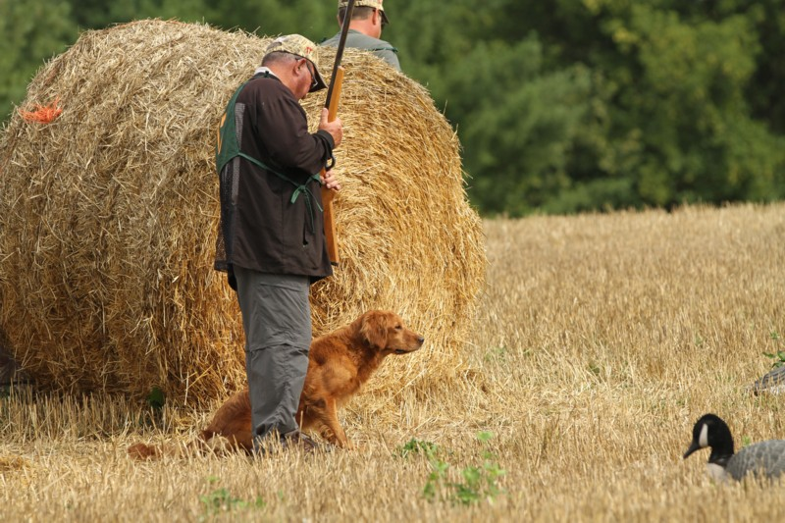
Gun Safety Cont’d
Anyone who handles firearms must also PROVE the firearm safe:
  Point the firearm in the safest available direction
  Remove all ammunition
  Observe the chamber
  Verify the feeding path
  Examine before each time you pick up a firearm

Slide 48
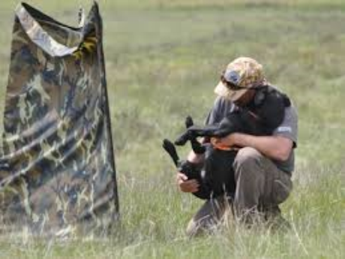
Perhaps Above All
Hunt tests should be an enjoyable sport in which handlers and their dogs get to work as a team and have fun
Thank you!

